Slide 1

Data Science, Artificial Intelligence, Machine Learning, Natural Language Processing, Deep Learning, Neural Network, Generative AI, Large Language Model, Prompt Engineering, Agentic AI
K. Prakash Senapati

Slide 2
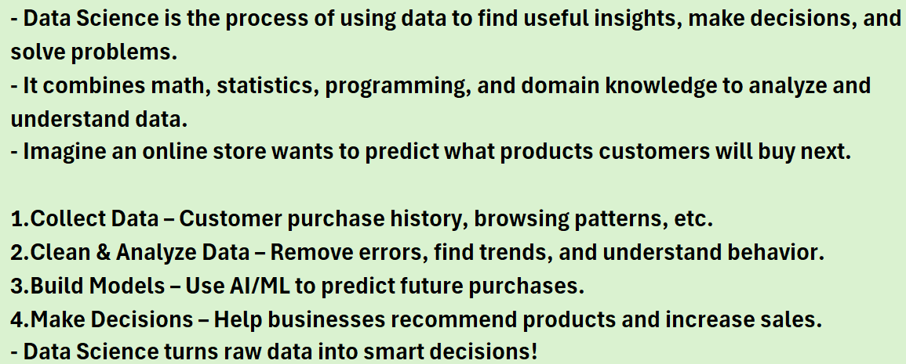
DATA SCIENCE

Slide 3
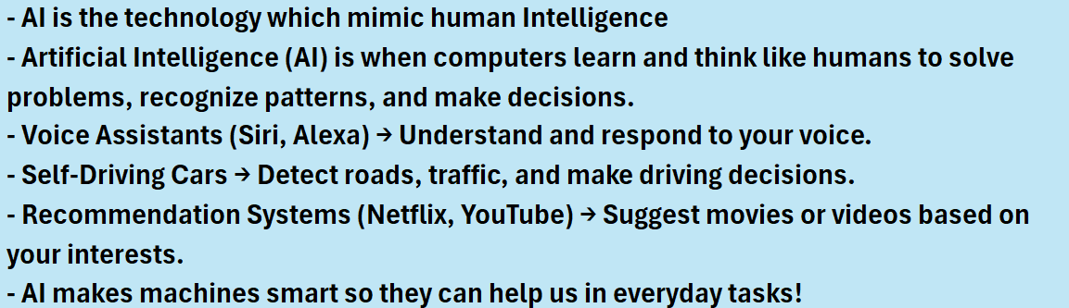
ARTIFICIAL INTELLIGENCE

Slide 4
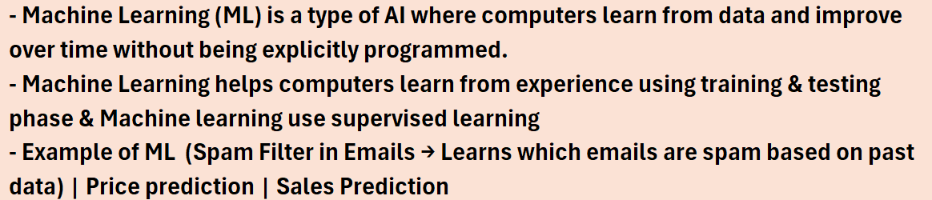
MACHINE LEARNING

Slide 5
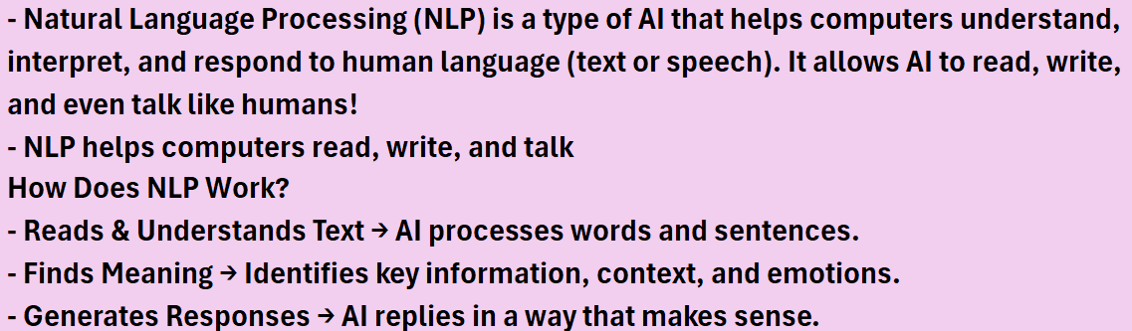
NATURAL LANGUAGE PROCESSING

Slide 6
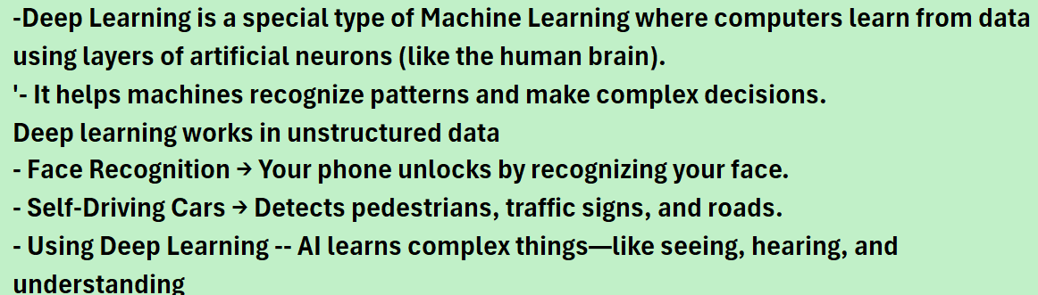
DEEP LEARNING

Slide 7
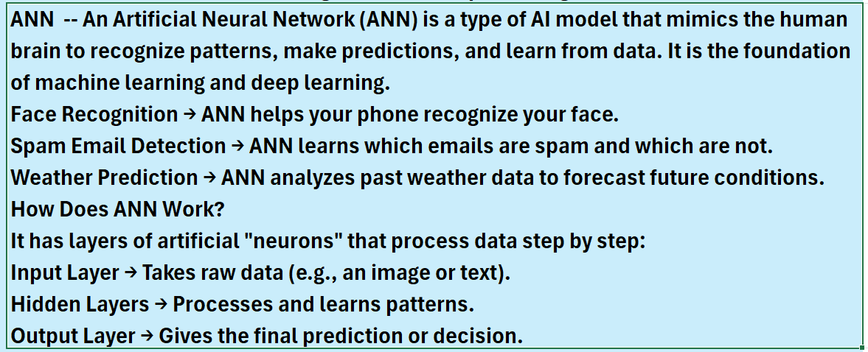
NEURAL NETWORK ANN (ARTIFICIAL NEURAL NETWORK)

Slide 8
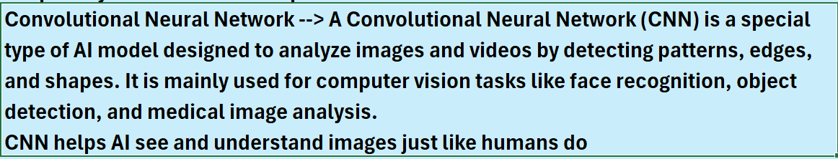
CNN(CONVOLUTIONAL NEURAL NETWORK)

Slide 9
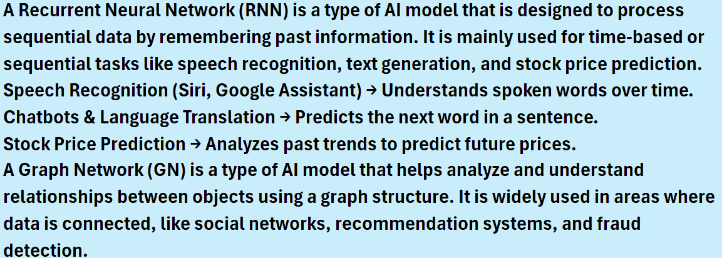
RNN(Recurrent Neural Network)

Slide 10
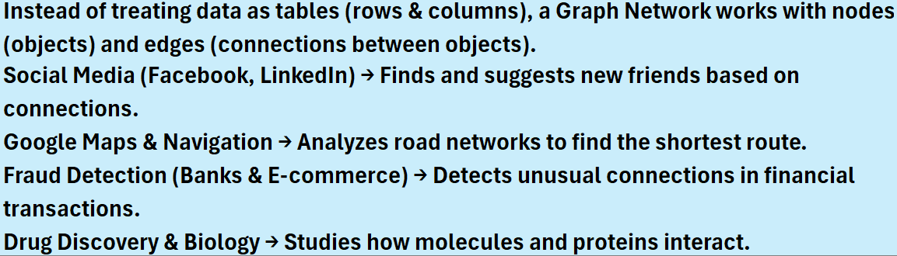
GNN (Graph Neural Network)

Slide 11
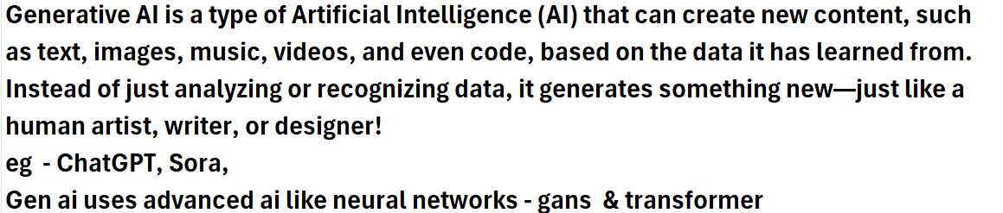
GENERATIVE AI

Slide 12
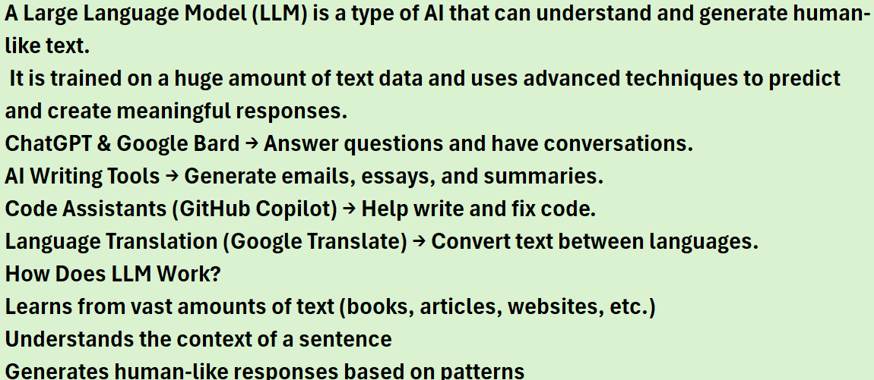
LARGE LANGUAGE MODEL (LLM)

Slide 13
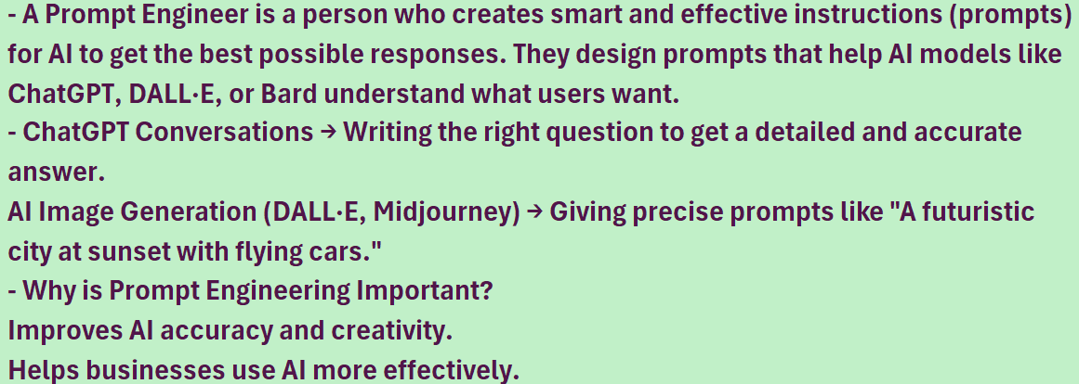
PROMPT ENGINEER

Slide 14
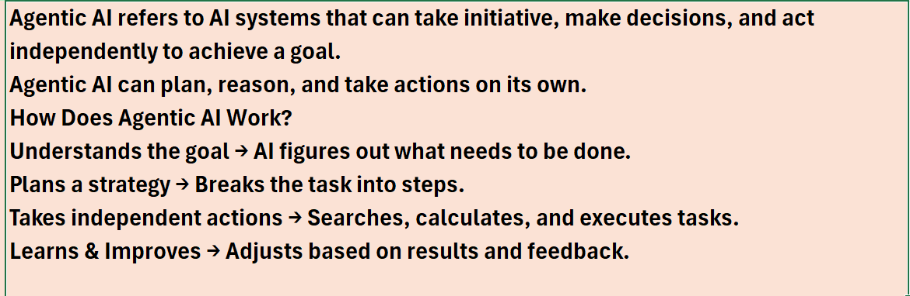
AGENTIC AI

Slide 15

1. Resume Building Bootcamp for Data Analytics, BA, Data Science & GEN AI Roles ➔ playlist?list=PLVlQHNRLflP-SaPff3325gkISMHEznEix 2. Agenitic AI ➔ playlist?list=PLVlQHNRLflP8Pt3wVlRWRaXZXi79cIwSq 3. Data Analytics & Business Analytics ➔ playlist?list=PLVlQHNRLflP-BgYmMlM8YQpvQM2J99HE0 4. Generative AI ➔ playlist?list=PLVlQHNRLflP81c99eg7UhkVZxwPvhTddM 5- 5. Python for Datascience ➔ playlist?list=PLVlQHNRLflP9GN5rc8sBWnrV53DWAzfdn 6. AZUR AI (Cognitive Services for Data Scientist) ➔ playlist?list=PLVlQHNRLflP8JthpjvJFaofUkJS1A7qa1

Slide 16
